Slide 1
Policy Debate Crash Course for Judges
Thank you for being here! You are incredible!

Slide 2
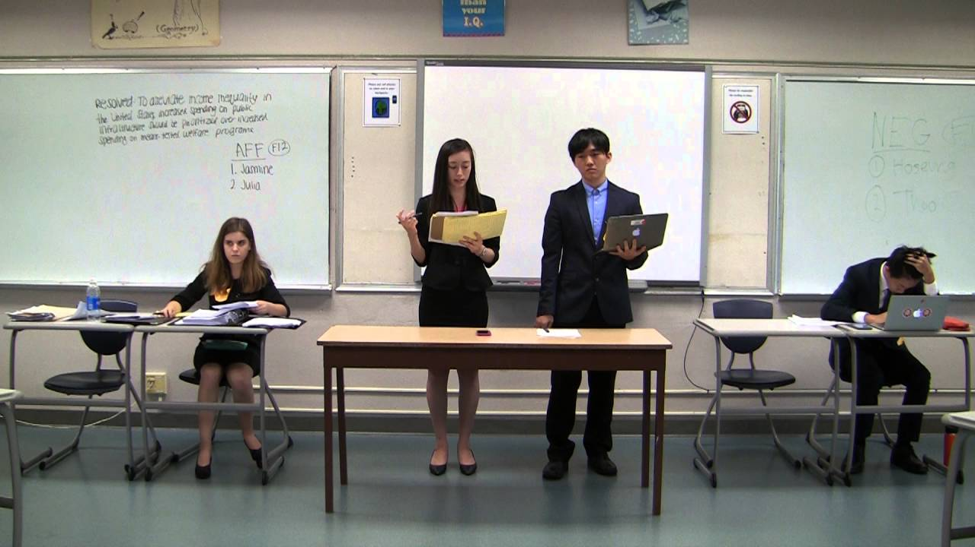
Don’t panic!
You are a voter. You cannot be wrong!

Slide 3
What is Policy Debate?
Debate is an educational activity that teaches student how to research information and present it in a form of organized arguments.
The goal of the Policy Debate round is to adopt the best policy proposed by the most convincing team.
Since you are a voter, you have the right to decide which policy you like (or dislike) the most.

Slide 4
What is a Debate Tournament?
Schedule
Round 1: 10:00 a.m. – 11:30 a.m.
Round 2: 11:30 a.m. – 1:00 p.m.
Lunch
Round 3: 2:00 p.m. – 3:30 p.m.
Round 4: 3:30 p.m. – 4:30 p.m.
Round Participants
2 teams of 2 students each
1 judge
Affirmative – defends Resolution
Negative – defends Status Quo
Teams are assigned to their sides
Teams don’t argue based on their beliefs

Slide 5
What will the teams debate about?
Resolved: The United States federal government should substantially reduce Direct Commercial Sales and/or Foreign Military Sales of arms from the United States.

Slide 6
What will you see in the round?
Podium
Negative Team
Affirmative Team
Judge

Slide 7
Team’s role: Affirmative
Burden of proof - prove that change, a.k.a. Resolution, is necessary. Status Quo is bad.
Significance and Harms – identify a significant problem.
Inherency – explain why the problem is not fixed now.
Topicality - propose a plan within the resolution.
Solvency – solve the problem; improve the current Status Quo.
Advantages – bonus GOOD things that will happen after the plan is implemented.

Slide 8
Team’s role: Negative
Presumption – assumes that Status Quo is good; no need for Resolution.
Significance and Harms –the problem is not big/bad.
Inherency – the problem is solved/will solve itself.
Topicality – the proposed plan IS NOT within the resolution.
Solvency – the plan doesn’t solve the problem.
DisAdvantages – BAD things will happen after the plan is implemented.

Slide 9
Evidence
Teams will use evidence to prove their claims. Evidence (cards) can be in a paper or electronic form.
Evidence must be prepared before the round. Web search during the round is a ground for disqualification.
Teams must share their evidence with the opponent upon request – on paper or on a flash drive. The evidence must be returned upon request.
Teams will challenge each other’s evidence on currency, reliability, authority, accuracy, and pertinence.

Slide 10
Give and Take
Affirmative has rights to FIAT – rights to pass the plan through the U.S. Congress.
Negative has rights to request topicality – debate only the plans within the resolution.

Slide 11
What “ground” are they talking about?
Status Quo
Neg ground
AFF ground
Poverty
Resolution
Hunger
Bad Haircuts
Education
Pollution
Healthcare

Slide 12
Arrival
Arrive 10-15 minutes prior to your first round
Register at the Judges’ Table, verify your room number, and receive the ballot.
Food and drinks @ the Hospitality Room from 9:30 till 4:00.

Slide 13
Before the round begins
Invite teams to sign the ballot: they will introduce themselves and put their names on the ballot. Have a pen!
“What is your paradigm?” – “I am a community judge. Please speak clearly, follow the rules, stay on time, and do your best.”
“Road map on time?” – NO. It’s a KSHSAA rule.
“May I use my phone for timing?” – Yes. On Airplane Mode.
Judge is not allowed to time students’ speeches.
Judge ready? – Yes!

Slide 14
Observers
Students, parents, and coaches FROM the SAME SCHOOL as competitors may observe the round.
Observers from OTHER schools are NOT allowed.
Only observers from the AFF team are allowed to flow (take notes).
Observers are NOT allowed to COMMUNICATE with the debaters.
In case of any disputes, please send a student to the Judge Registration table to fetch me.

Slide 15
Time is important
Constructive Speeches
1st Aff. Constructive Speech 8 min.
1st Aff. Is CX by 2nd Neg. 3 min.
1st Neg. Constructive Speech 8 min.
1st Neg. is CX by an 1st Aff. 3 min.
2nd Aff. Constructive Speech 8 min.
2nd Aff. is CX by the 1st Neg. 3 min.
2nd Neg. Constructive Speech 8 min.
2nd Neg. is CX by the 2nd Aff. 3 min.
No new arguments from this point on – new evidence allowed.
Rebuttal
1st Negative 5 min.
1st Affirmative 5 min.
2nd Negative 5 min.
2nd Affirmative 5 min.
Prep time is 8 minutes for each team; can be taken in increments; can’t be used for speech.

Slide 16
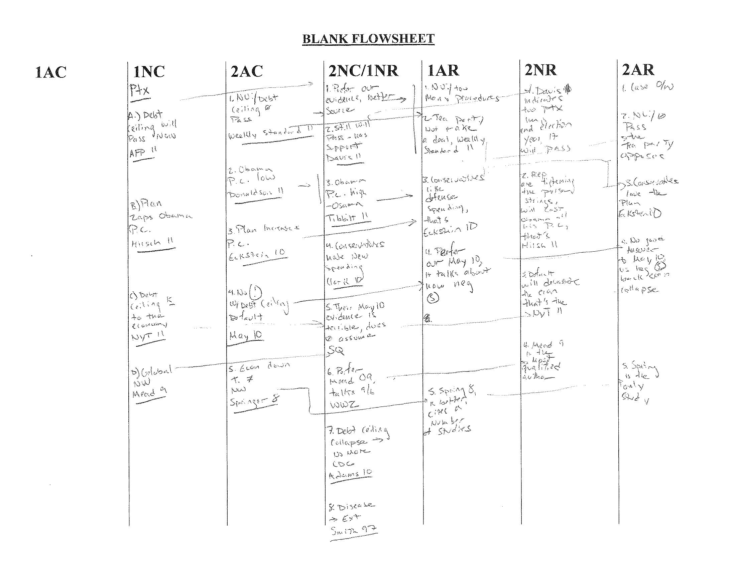
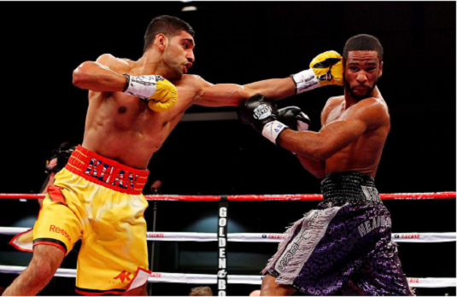
Note taking

Slide 17
Note taking: you can do it this way
1Aff- John
Pl. stop sells to Taiwan b/c China
Adv. Terror. Good speaker. Strong CX
1Neg. - Maria
T “reduce”, T “substantial”
Terror not solved; Disad. China war w/ Taiwan. Need more evidence.
2Aff - Mary
Answ. T reduce, not ans. T substant.
Need confidence in CX; didn’t answer terror; speak louder.
2Neg - Jose
No solven. No terror adv. No solv. China. Econ bad.
Strong Rebuttal speech.
Vote: T to Neg, Solvency to Neg, Economy – to Aff., Terror - Neg
Decision: I vote Neg because Aff didn’t solve for relation w/ China and terror. Both teams are great speakers, but Aff needs more evidence.

Slide 18
Can you interact with the teams?
NOT DURING speeches – they are timed.
You can ask teams to show you their evidence in case of a dispute ONLY (not authentic, cheating, unfair).
It’s best to leave the questions until the end of the round.
You can give students feedback and ask questions before you finish writing your ballot.
DO NOT REVEAL your DECISION. Don’t show the ballot

Slide 19
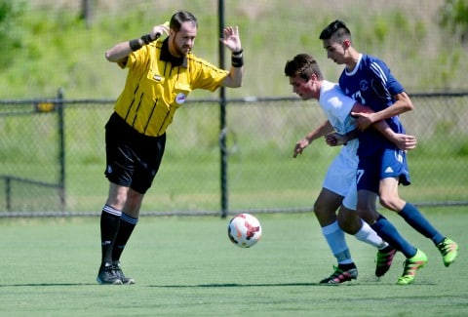
Making Your Decision
You cannot make a mistake. A better debater always wins.
Teams are assigned Aff and Neg sides – don’t hold it against them.
Do not participate is debate – judge it!
You are not voting for the issue – you are voting for a better debate team, the one who delivered their argument better.
Assign the winner. Rate the speakers – the winning team must receive no mere than 5 speaking points .
Explain your decision.
Give some specific feedback to each student, or at least each team.

Slide 20
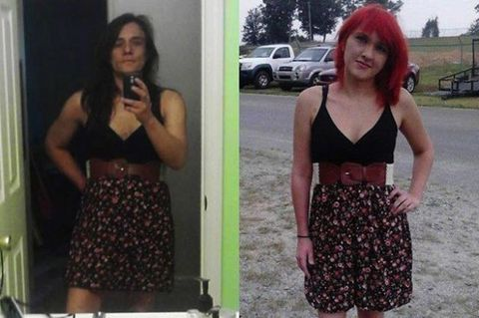
Giving verbal and written feedback
Be respectful – you are an adult, you must set an example. Don’t say or write mean things.
Be fair – don’t discriminate against girls, weaker debaters, kids who don’t “look good.”
Be constructive – phrase your comments in positive way: “Make eye contact” vs. “Don’t stare at the computer”; “Research …” vs. “You have no clue about …”
Explain your choice - Write something!

Slide 21
Filling the Ballot
Choose the winner – no ties.
Write the reason for your decision (why did you choose Aff or Neg)
Rank the speakers from 1 (best) to 4 (weakest) – no ties.
The winning team’s speakers’ points must be 5 or less (1+2, 1+3, or 2+3).
Give the speakers constructive criticism of their performance
Sign the ballot

Slide 22
Decision based on Stock Issues:
1. Significance/Harms
The Affirmative will try to prove that there is a significant problem in the present system (status quo).
Example: The U.S. major buyer of arms is Saudi Arabia. They use arms against Yemen civil population.
The Negative will try to prove that there is no problem or the problem is not significant.

Slide 23
Decision based on Stock Issues:
2. Inherency
The Affirmative will try to prove that there is no current or pending solution to the described problem.
Example: President Trump vetoed all Congress’s attempts to reduce sales. Let’s stop selling to Saudi completely.
The Negative will try to prove that the current system already solved or is solving the problem.
Example: The U.S. leads negotiations with Saudi about Yemen.

Slide 24
Decision based on Stock Issues:
3. Topicality
The Affirmative must build their case only within the framework of the Resolution (see above Debate Topic).
Example: Plan: The U.S.F.G. must stop sales of handguns to Philippines.
The Negative will try to prove that the plan is not topical (i.e. “handguns” are not “arms”; “stop” does not mean “reduce,” etc.)
If the judge agrees that the Plan is non-topical, the Neg wins!

Slide 25
Decision based on Stock Issues:
4. Solvency
The Affirmative must solve the harms that they identified in their case.
Example: Stopping arms sales reduces terrorism in the region.
The Negative will try to prove that the plan does not solve the problem.
Example: Stopping arms sales reduces hegemony of the U.S. in the world.
If the judge agrees that the Plan does not solve, Neg wins!

Slide 26
Decision based on Stock Issues:
5. Advantages
The Affirmative may provide several additional advantages that will happen as a result of the Plan
Example: Economy improves when we sell less guns.
The Negative will try to prove that Advantages are not real or not significant to outweigh Disadvantages
Example: China will start nuclear war if we’ll stop selling guns.
The judge should weigh the impact of Advantages vs. Disads.

Slide 27
Decision Making Based on Common Sense
As a real world voter, you can judge the outcomes of the round based on which team presents a better argument, creates a better educational event, or are better speakers/debaters.
Please strive to be objective and refrain from basing your judgment on your political beliefs.
Example of bias decision: Aff presented a strong argument for stopping selling arms to Mexico, and Neg didn’t say anything about economy, but you think that it will hurt economy, so you vote Neg.

Slide 28
Thank You for Judging!
Sincerely,
Sacred Heart Debate

